Slide 1
Basic Computer Organization
Course Teacher
Nazmun Nessa Moon
Associate Professor
Dept. of CSE, DIU

Slide 2
Learning Objectives
In this lecture you will learn about:
Basic operations performed by all types of computer systems
Basic organization of a computer system
Input unit and its functions
Output unit and its functions
Storage unit and its functions
Types of storage used in a computer system
Arithmetic Logic Unit (ALU)
Control Unit (CU)
Central Processing Unit (CPU)
Computer as a system

Slide 3
The Five Basic Operations of a Computer System
Inputting. The process of entering data and instructions into the computer system
Storing. Saving data and instructions to make them readily available for initial or additional processing whenever required
Processing. Performing arithmetic operations (add, subtract, multiply, divide, etc.) or logical operations (comparisons like equal to, less than, greater than, etc.) on data to convert them into useful information
Outputting. The process of producing useful information or results for the user such as a printed report or visual display
Controlling. Directing the manner and sequence in which all of the above operations are performed

Slide 4
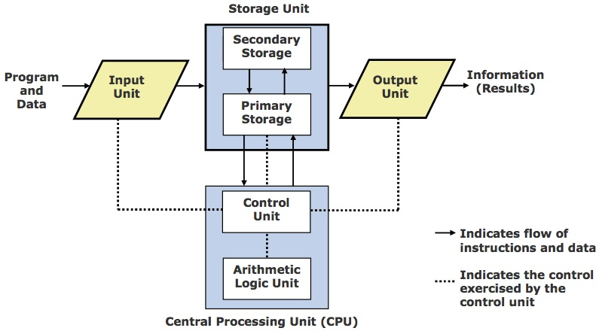
Basic Organization of a Computer System

Slide 5
Input Unit
An input unit of a computer system performs the following functions:
It accepts (or reads) instructions and data from outside world
It converts these instructions and data in computer acceptable form
It supplies the converted instructions and data to the computer system for further processing

Slide 6
Output Unit
An output unit of a computer system performs the following functions:
It accepts the results produced by the computer, which are in coded form and hence, cannot be easily understood by us
It converts these coded results to human acceptable (readable) form
It supplies the converted results to outside world

Slide 7
Storage Unit
The storage unit of a computer system holds (or stores) the following :
Data and instructions required for processing (received from input devices)
Intermediate results of processing
Final results of processing, before they are released to an output device

Slide 8
Two Types of Storage
Primary storage
Used to hold running program instructions
Used to hold data, intermediate results, and results of ongoing processing of job(s)
Fast in operation
Small Capacity
Expensive
Volatile (looses data on power dissipation)

Slide 9
Two Types of Storage
Secondary storage
Used to hold stored program instructions
Used to hold data and information of stored jobs
Slower than primary storage
Large Capacity
Lot cheaper than primary storage
Retains data even without power

Slide 10
Arithmetic Logic Unit (ALU)
Arithmetic Logic Unit of a computer system is the place where the actual executions of instructions takes place during processing operation

Slide 11
Control Unit (CU)
Control Unit of a computer system manages and coordinates the operations of all other components of the computer system
The control unit is a component of a computer's central processing unit (CPU) that directs operation of the processor. It controls communication and co-ordination between input/output devices. It reads and interprets instructions and determines the sequence for processing the data.
It directs the operation of the other units by providing timing and control signals.
All computer resources are managed by the CU (Control Unit).
It directs the flow of data between the Central Processing Unit (CPU) and the other devices.

Slide 12
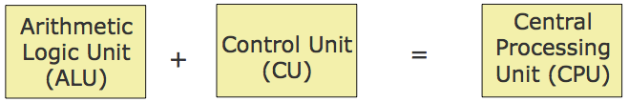
Central Processing Unit (CPU)
It is the brain of a computer system
It is responsible for controlling the operations of all other units of a computer system

Slide 13
The System Concept
A system has following three characteristics:
A system has more than one element
All elements of a system are logically related
All elements of a system are controlled in a manner to achieve the system goal
A computer is a system as it comprises of integrated components (input unit, output unit, storage unit, and CPU) that work together to perform the steps called for in the executing program

Slide 14
Key Words/Phrases
Arithmetic Logic Unit (ALU)
Output interface
Auxiliary storage
Output unit
Central Processing Unit (CPU)
Outputting
Computer system
Primate storage
Control Unit (CU)
Processing
Controlling
Secondary storage
Input interface
Storage unit
Input unit
Storing
Inputting
System
Main memory

